Slide 1
Moon Rover
Automation
Billy McGloin
Georgetown M.S. Data Science & Analytics, 2025

Slide 2
TABLE OF CONTENTS
01
RL Overview
02
The Environment
Core Concepts
Simulating the Moon’s Terrain
03
Training the Rover
04
Beyond the Classroom
Applying RL to Navigate Lunar Terrain
Real Data & NASA Collaboration

Slide 3
01
Reinforcement Learning Overview
Core Concepts

Slide 4

Temporal Decision Making in Complex Stochastic Environments

Slide 5
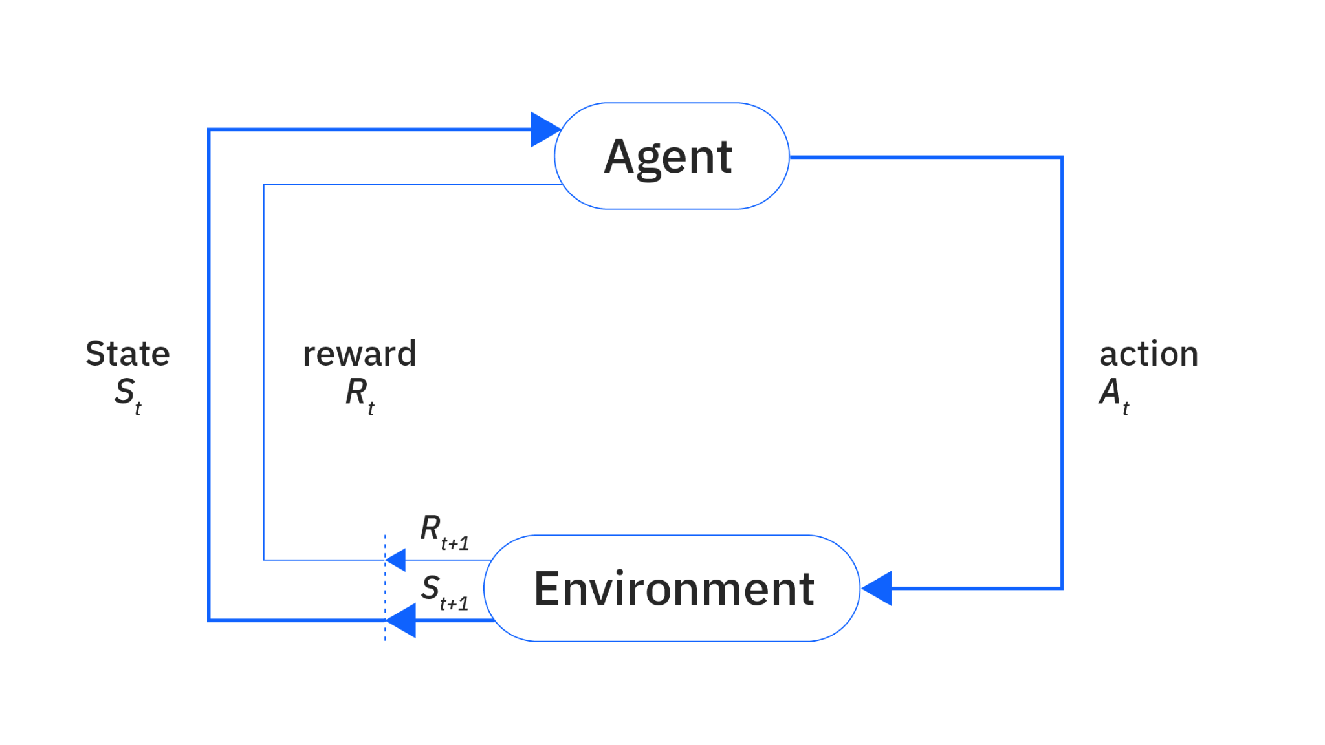
The RL Framework
https://www.ibm.com/think/topics/reinforcement-learning
Notes:
Reinforcement learning is built on the interaction between an agent and an environment, structured as a feedback loop. At each time step, the agent observes the current state, denoted as S_t , and selects an action, A_t , based on its policy. This action affects the environment, which then transitions to a new state, S_{t+1} , while providing a reward, R_{t+1} , as feedback on how good or bad the action was.
Over time, the agent’s goal is to learn an optimal policy—essentially, a strategy for picking actions that maximize cumulative rewards over time. But how does the agent actually determine which actions are best? That brings us to value estimation.

Slide 6
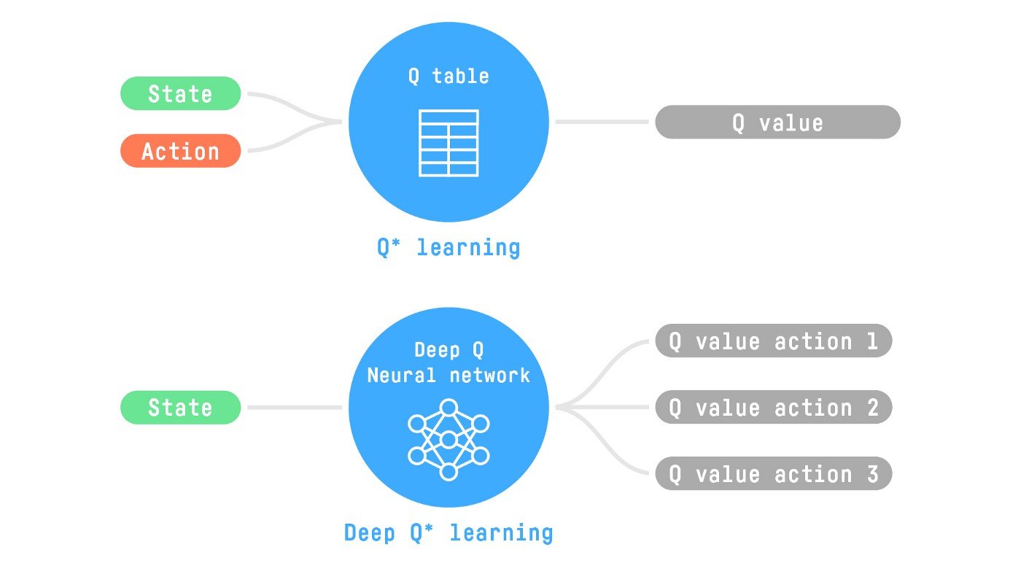
Deep RL
https://huggingface.co/blog/deep-rl-intro
Notes:
To learn effectively, the agent needs to estimate the value of actions or states. This can be done using two main approaches:
1. State-value functions, which estimate the long-term reward for being in a given state and following a certain policy.
2. Action-value functions, which estimate the long-term reward for taking a specific action in a given state. https://www.ibm.com/think/topics/reinforcement-learning
In simple environments—we can store these values explicitly in a table, using tabular methods like Q-learning or Dynamic Programming. These approaches work when the state space is small and manageable.
However, in more complex environments—like controlling a moon rover—the number of possible states becomes enormous. Keeping a table for every possible state-action pair is infeasible. So instead of storing values explicitly, we use Deep Reinforcement Learning, where neural networks approximate these values.
Deep RL allows us to handle continuous, high-dimensional state spaces. Instead of storing a lookup table of values, a neural network learns to predict the best actions based on past experiences. This enables RL to scale to environments where the number of states and actions is too large to handle explicitly.
There are two main approaches to Deep RL: Model-Free and Model-Based methods.
• Model-Free RL learns purely from experience, directly mapping states to actions using methods like Q-learning or policy optimization. This is what we use in our rover training, specifically with Soft Actor-Critic (SAC)—a model-free approach that balances exploration and exploitation efficiently
• Model-Based RL tries to learn a model of the environment, predicting how actions will affect future states and rewards. This is useful when we have prior knowledge about the system dynamics, which we may integrate in future work with NASA’s real-world data.

Slide 7
02
The Environment
Simulating the Moon’s Terrain

Slide 8
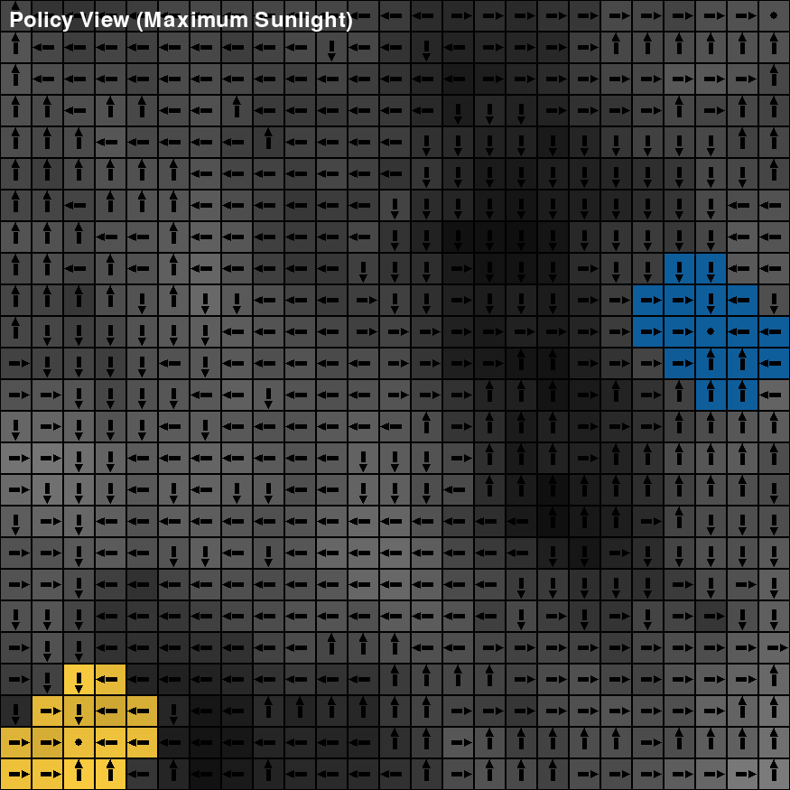
From Grid-World to the Moon: Navigating the Unknown
Simulated Moon Terrain
🏔️ Altitude
🌑 Dust
☀️ Sunlight
Avoiding Hazards
⚠️ Crashes
🚧 Getting Stuck
🔋 Battery Depletion
Rover Learns to Explore and Adapt
🏆 Resource updates

Slide 9

6 Possible Actions
Up
Down
Left
Right
Stay
Gather

Slide 10
Reward Structure
Steps
}
Energy
We penalize per step to reward shorter trips
We penalize when the battery power is < 20% of full capacity
Sunlight, Dust, and Height all affect Battery Usage
Resource
Rewards when the rover gathers a resource

Slide 11
Training The Rover
03
Applying RL to Navigate Lunar Terrain

Slide 12
Soft Actor-Critic (SAC)
🎭 Model-Free, Off-Policy
🎲 Entropy-based optimization
📉. Reduces Estimation for Stable Learning
Notes:
Once we defined the environment and reward structure, the next step was training the agent to navigate the simulated lunar terrain. We explored multiple reinforcement learning algorithms, but today I’m going to delve very briefly into Soft Actor-Critic (SAC).
SAC is a model-free, off-policy reinforcement learning algorithm that balances two key aspects: exploration and exploitation. Unlike traditional methods that prioritize immediate rewards, SAC introduces an entropy term, encouraging the agent to explore more diverse actions rather than always picking the highest-value option. This helps avoid getting stuck in suboptimal behaviors.
Training involves the agent interacting with the environment, collecting experience, and updating two key components:
1. Actor (Policy Network): Learns the best action to take in each state.
2. Critic (Value Network): Estimates the expected return for a given action.
By continuously refining these networks through experience replay and gradient updates, the rover gradually learns to navigate efficiently.
Next, let’s look at the results—how our trained policy performs in the lunar simulation.

Slide 13
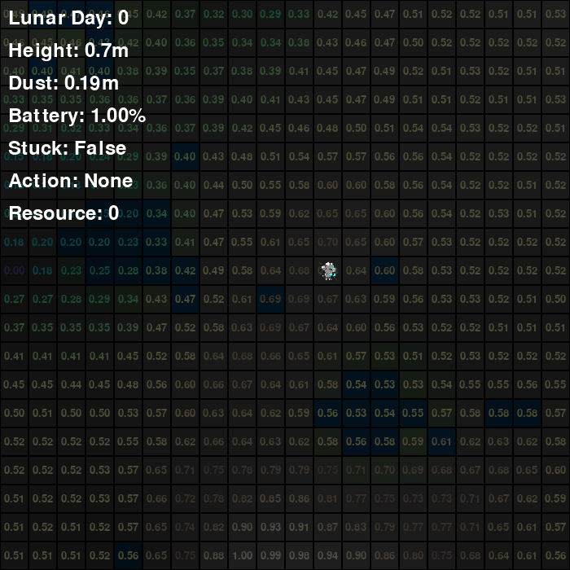
Policy Visualization

Slide 14
Beyond the Classroom
04
Real Data & NASA Collaboration
Notes:
Real world data – in terms of terrain, light modeling, etc. Focusing on resource collection and collecting more than just one type of resource

Slide 15
NASA Collaboration
Lunar South Pole
Diversity of Resources
Feedback from NASA Scientists
Incorporating Real-Life Data for Terrain & Lights
Importance of Sampling Different Resources

Slide 16
THANKS!
Special thanks to Kangheng Liu, Shriya Chinthak, Jorge Bris Moreno, Eric Dapkus, James Hickman, & Prabal Saxena

Slide 17

Disclaimer: Only questions sent from Earth will be answered to the best of my capabilities.
Questions?

Slide 18


